Slide 1
Automatic detection and recognition of the text using the Maximum stable extremal regions and Stroke width transform in unstructured scenes
CENG 5131-Engineerng Applications
Monishkanna Barathan,
(1589389)

Slide 2
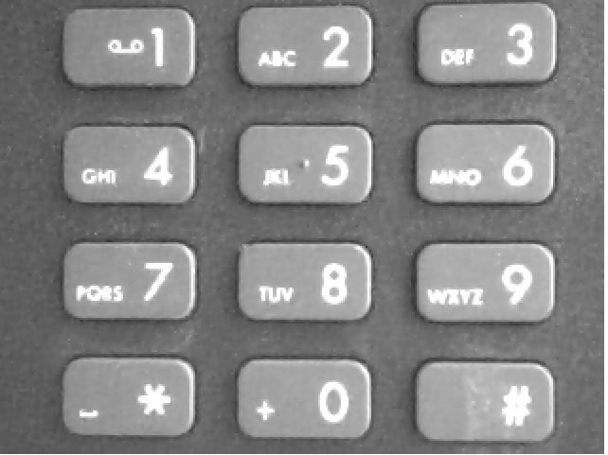
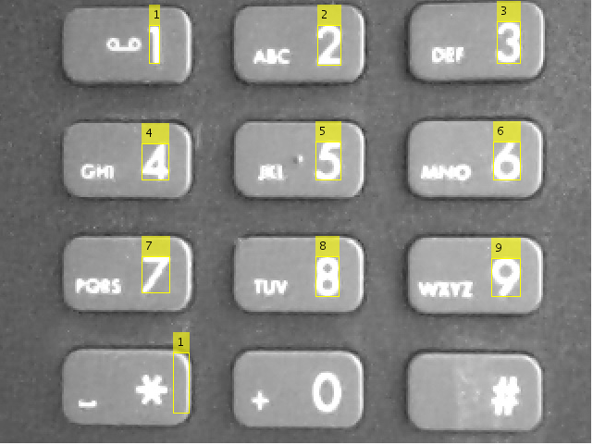
Why this project?
OCR performs best when the text is located on a uniform background and is formatted like a document
Consider the below example
Preprocessing
(Source : Mathworks)
For natural images - we need to segment the text from natural scenes will help OCR to obtain accurate results

Slide 3
Block Diagram
Input image
Convert it to gray scale to preprocessing
Detecting MSER regions to detect text regions
Removing non text regions based on basic geometric properties
Recognize detected text using OCR
Merging text regions for final detection
Removing non text regions based on stroke width transform

Slide 4
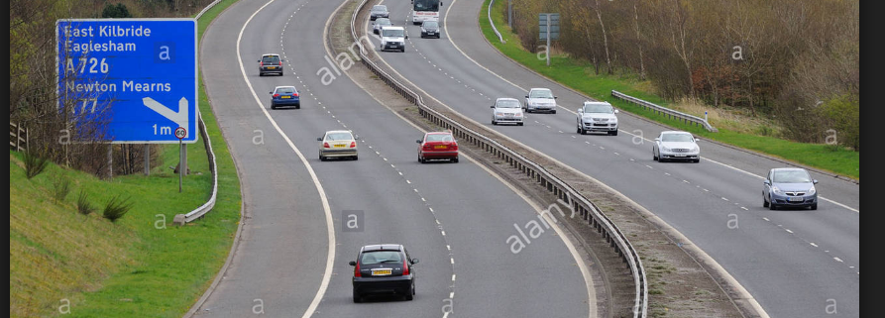
Input
v = VideoReader('truck_front_input.mp4');
1 st frame: video = read(v,1);
last frame: video = read(v,Inf);

Slide 5
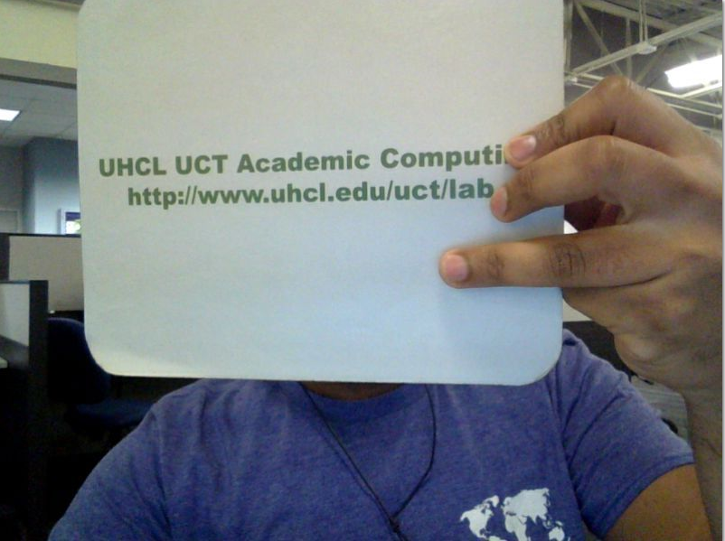
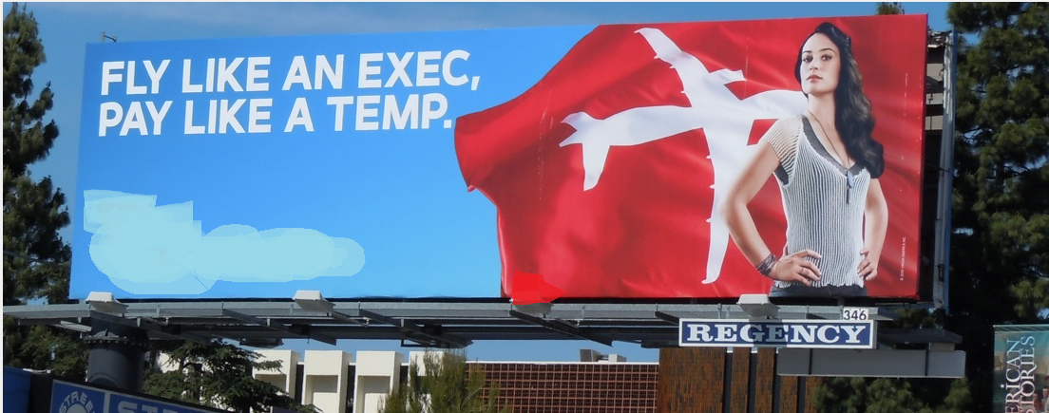
Input
v = VideoReader('truck_front_input.mp4');
1 st frame: video = read(v,1);
last frame: video = read(v,Inf);
(OR)
monish_input = imread('a3.png');
figure,imshow(monish_input),title('Original Image')
m_grayImage = rgb2gray(monish_input);
figure,imshow(m_grayImage),title('Original Image in gray')

Slide 6
Detecting MSER regions
The MSER feature detector works well for finding text regions . It works well for text because the consistent color and high contrast of text leads to stable intensity profiles.

Slide 7
Detecting MSER regions
The MSER feature detector works well for finding text regions . It works well for text because the consistent color and high contrast of text leads to stable intensity profiles.
[regions,cc] = detectMSERFeatures(I)optionally returns MSER regions in a connected component structure.
Use the detectMSERFeatures function to find all the regions within the image and plot these results.
Notice that there are many non-text regions detected alongside the text.

Slide 8
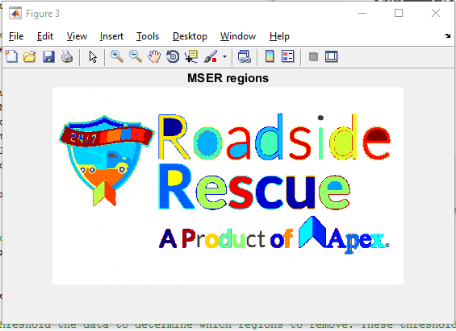
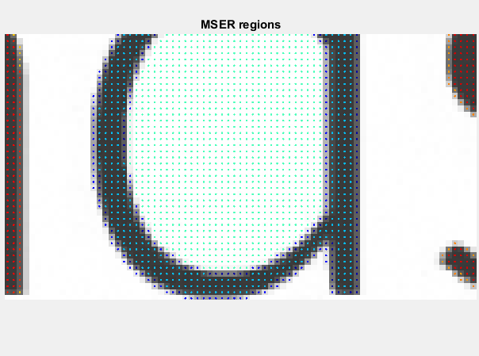

MSER

Slide 9
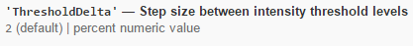
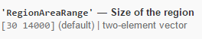
MSER Code
[mserRegions, mserConnComp] = detectMSERFeatures(m_grayImage, ...
'RegionAreaRange',[200 7800],'ThresholdDelta',4);
Decrease this value to return more regions. Typical values range from 0.8 to 4.
The vector, [minArea maxArea], allows the selection of regions containing pixels to be between minArea and maxArea

Slide 10
Geometric Properties
There are several geometric properties that are good for discriminating between the text and non-text regions
Aspect Ratio (width/height)
Eccentricity (0-circle and 1-line segment)
Euler Number (to determine discontinuities , >1 will have discontinuities)
Extent (area/area of bounding box)
Solidity (area/Convex area)

Slide 11
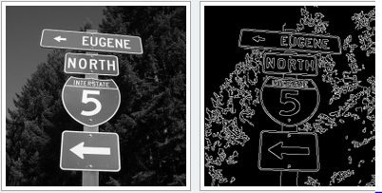
Stroke width transform
Stroke width is the measure of width od the curves and lines that make up a character.
Text regions tends to have a little strokes width variation whereas non text regions tend to have larger variation.
Binary distance transform, binary thinning operation

Slide 12
Merging the text regions
All the detection results are composed of individual text characters. To use these results for recognition tasks, such as OCR, the individual text characters must be merged into words or text lines. This enables recognition of the actual words in an image, which carry more meaningful information than just the individual characters.
For example, recognizing the string 'EXIT' vs. the set of individual characters {'X','E','T','I'}, where the meaning of the word is lost without the correct ordering.
One approach for merging individual text regions into words or text lines is to first find neighboring text regions and then form a bounding box around these regions.
To find neighboring regions, expand the bounding boxes computed earlier with regionprops.
This makes the bounding boxes of neighboring text regions overlap such that text regions that are part of the same word or text line form a chain of overlapping bounding boxes.

Slide 13
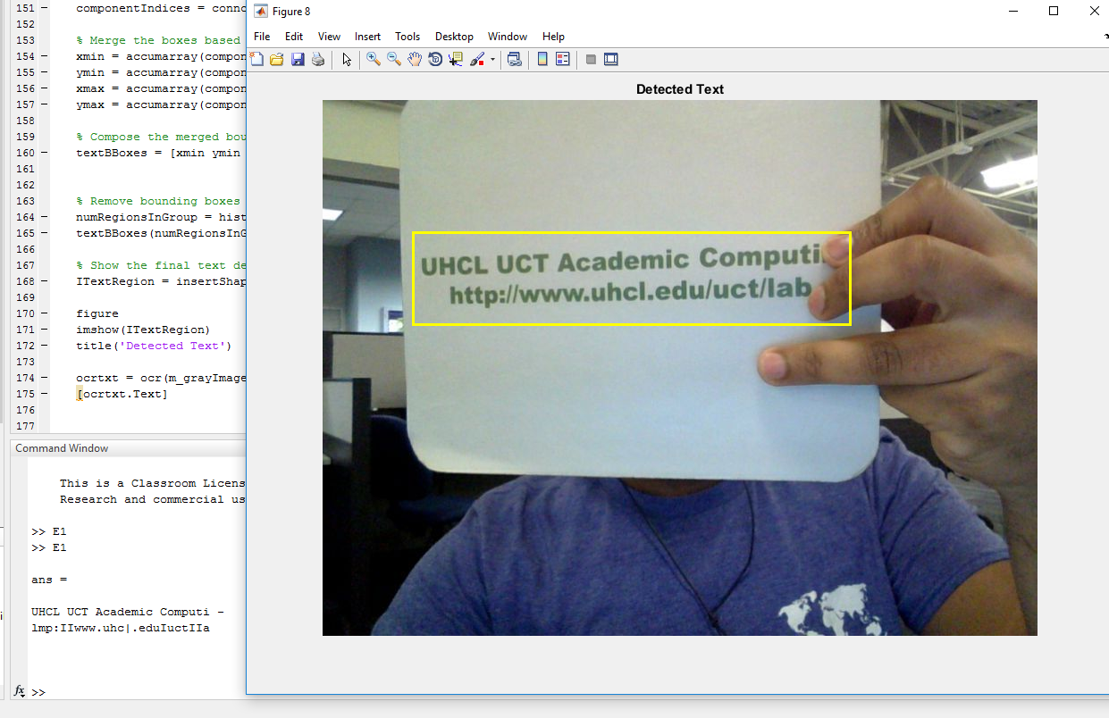
OCR
After detecting the text regions, use the ocr function to recognize the text within each bounding box
ocrtxt = ocr(I, textBBoxes);

Slide 14
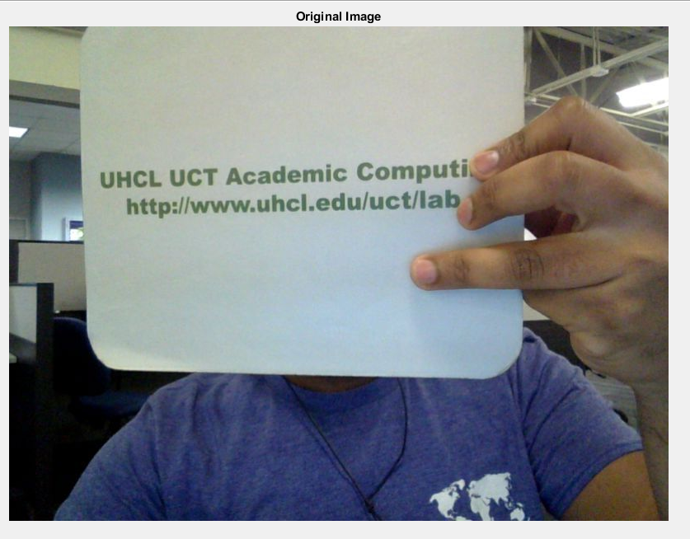
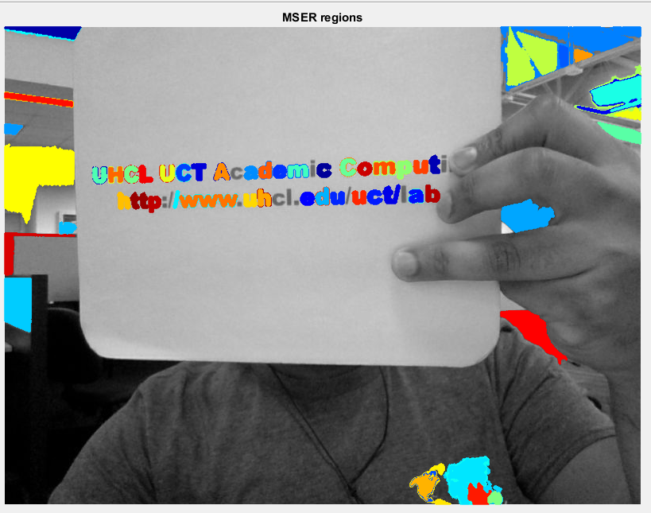
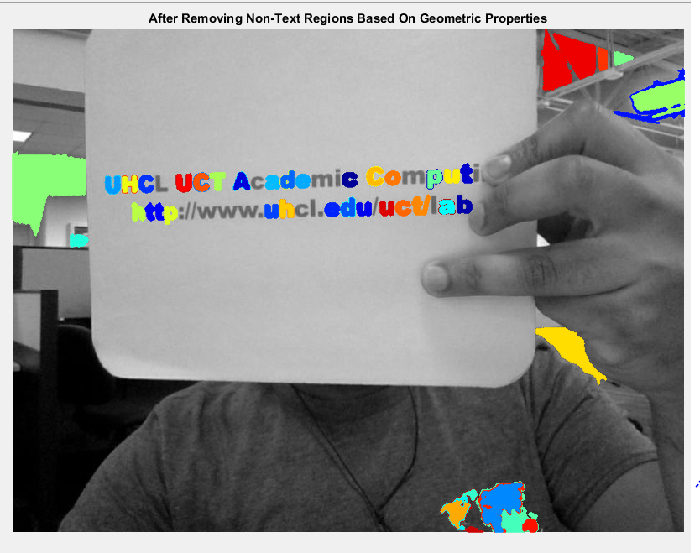
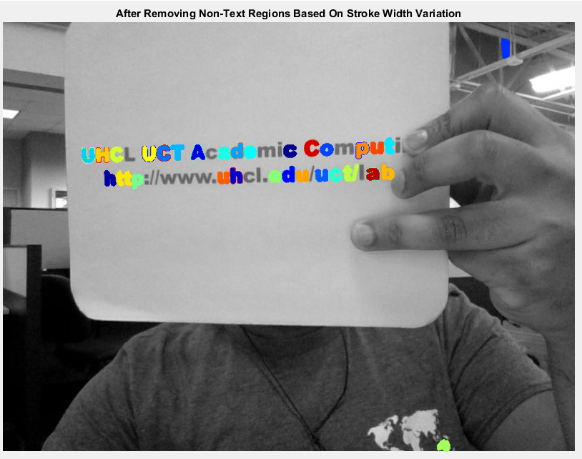
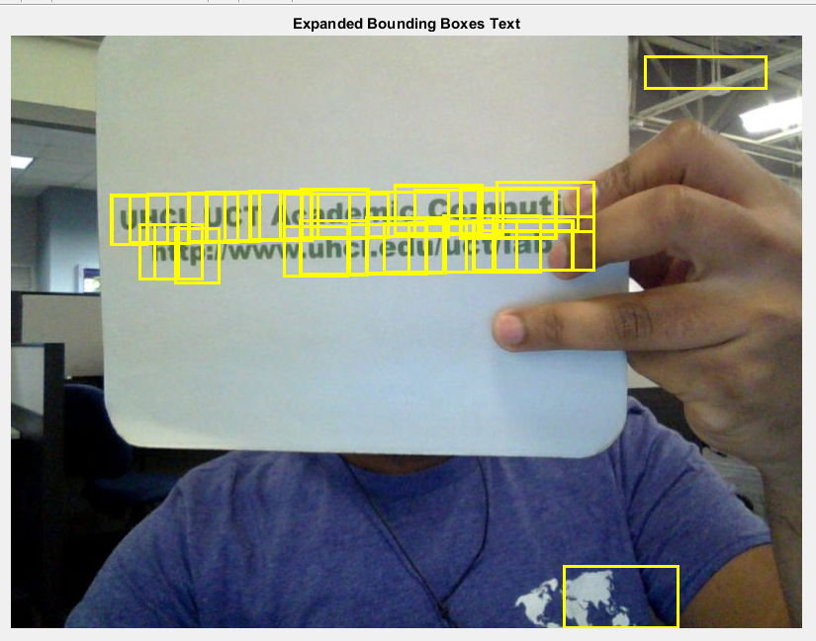
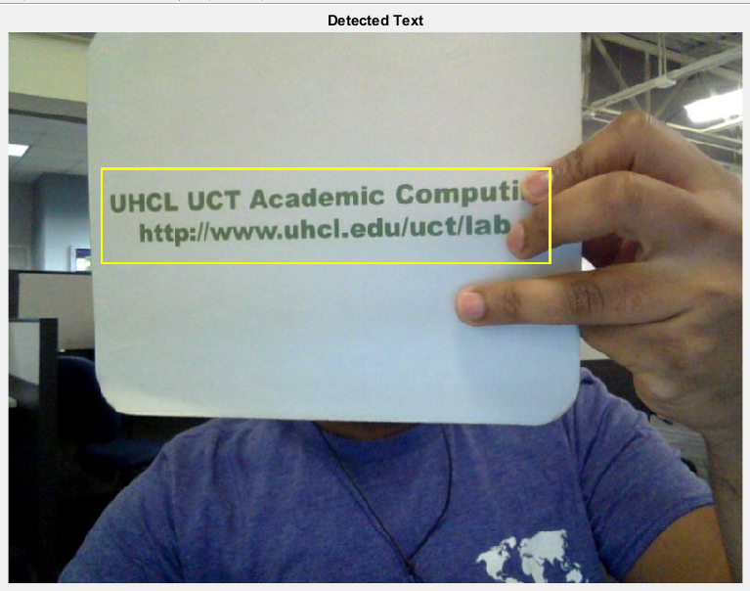
Results

Slide 15
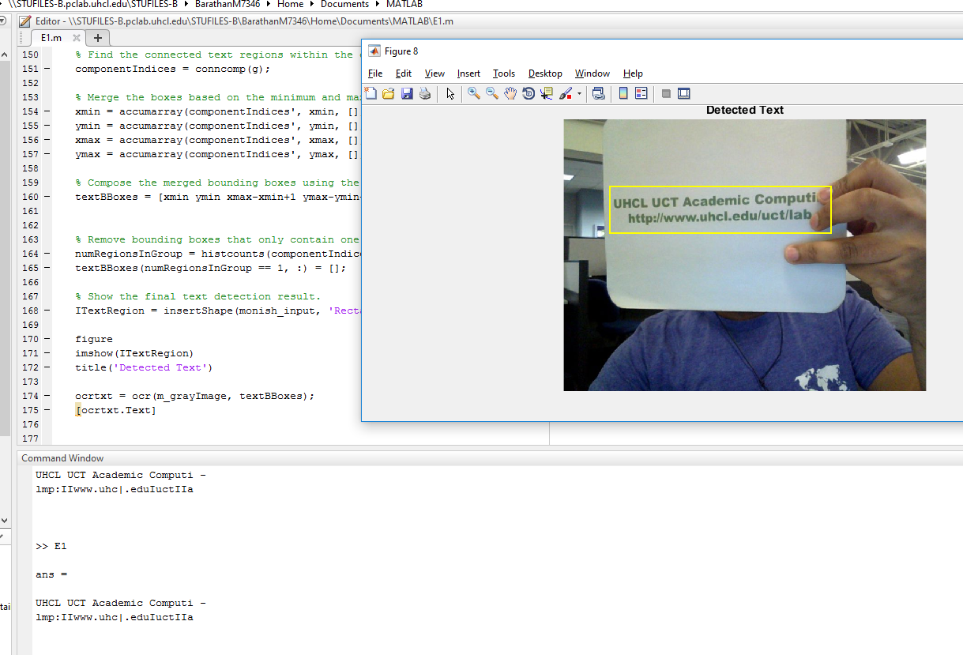
Result (Contd..)

Slide 16
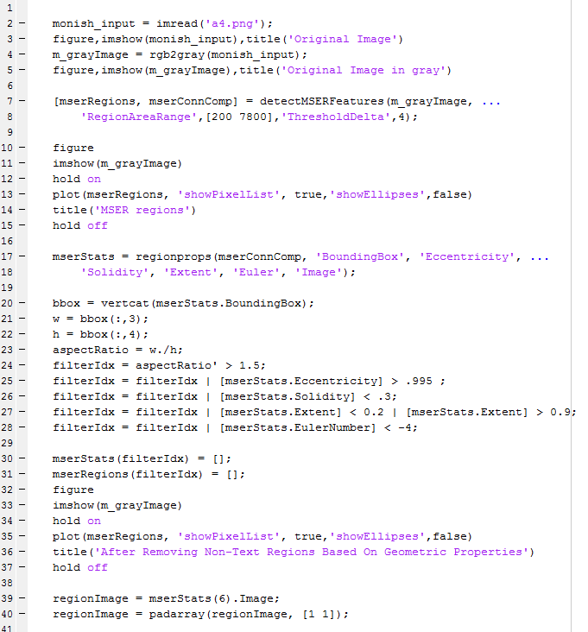
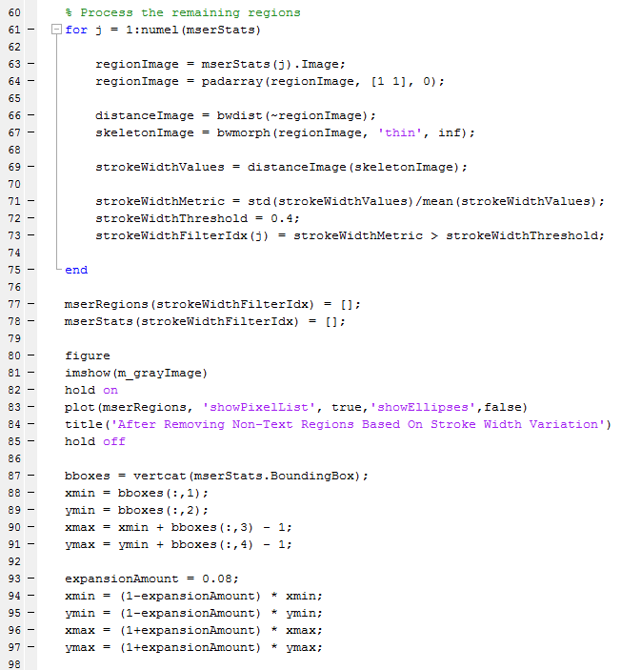
Matlab Code

Slide 17
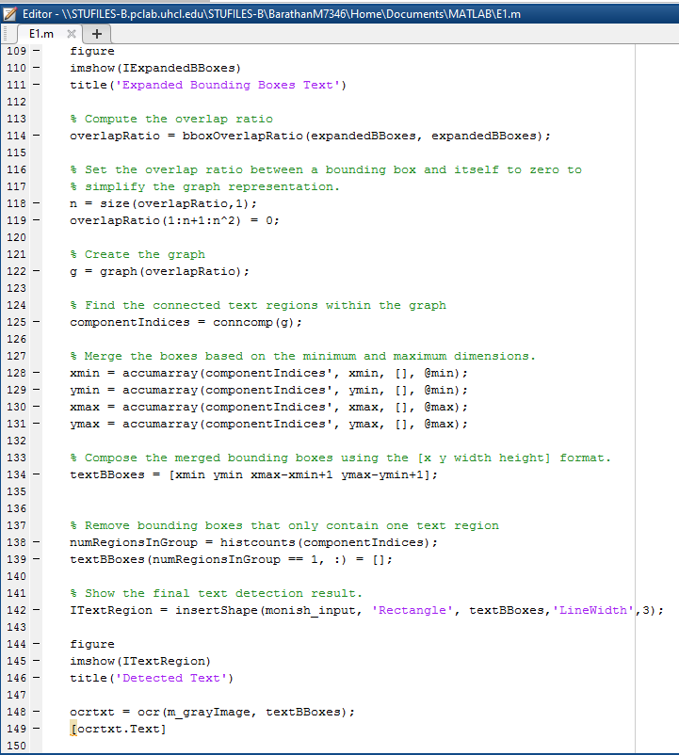
Matlab Code

Slide 18
References
[1] Chen, Huizhong, et al. "Robust Text Detection in Natural Images with Edge-Enhanced Maximally Stable Extremal Regions." Image Processing (ICIP), 2011 18th IEEE International Conference on. IEEE, 2011.
[2] Gonzalez, Alvaro, et al. "Text location in complex images." Pattern Recognition (ICPR), 2012 21st International Conference on. IEEE, 2012.
[3] Li, Yao, and Huchuan Lu. "Scene text detection via stroke width." Pattern Recognition (ICPR), 2012 21st International Conference on. IEEE, 2012.
[4] Neumann, Lukas, and Jiri Matas. "Real-time scene text localization and recognition." Computer Vision and Pattern Recognition (CVPR), 2012 IEEE Conference on. IEEE, 2012.
[5] website: https://www.mathworks.com/help/

Slide 19
Thank You
Questions?

